Slide 1






  Use and Management of Youth Spaces

Slide 2


Exploring existing youth space platforms
(focusing on weak and strong elements and how to involve more youth to take part)

Slide 3

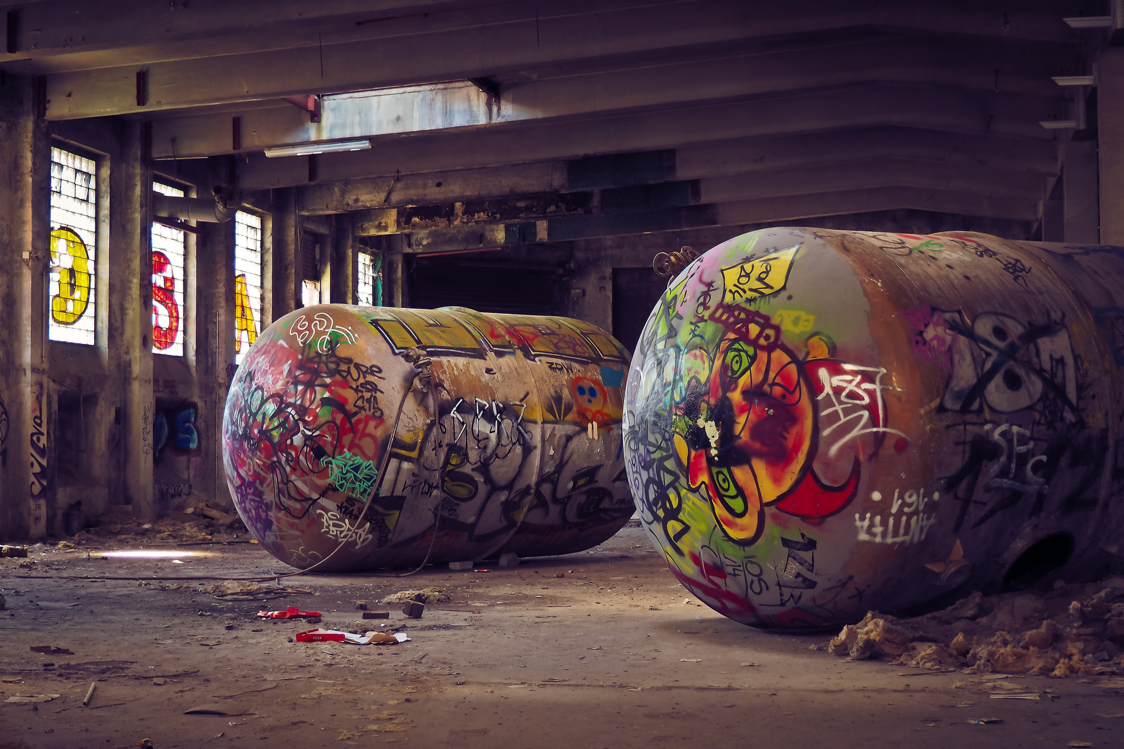



HTTPS://E-RESCUE.EU/

Slide 4



PLATFORM
01
to rehabilitate abandoned public areas by involving local actors to take ownership of the area
02
to create social links through innovative methods of non-formal education and citizen participation

Slide 5
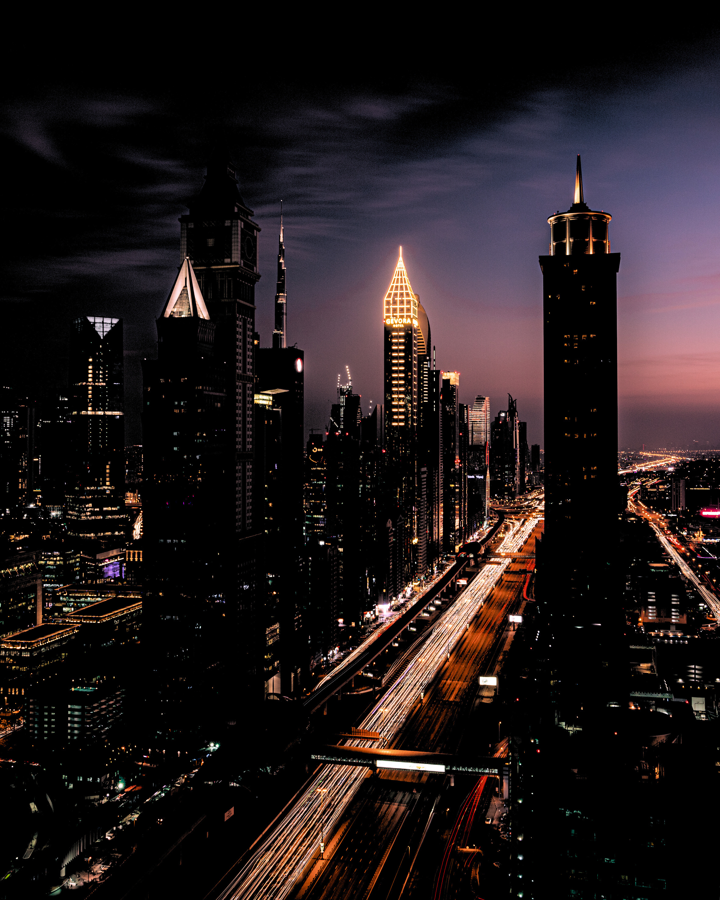
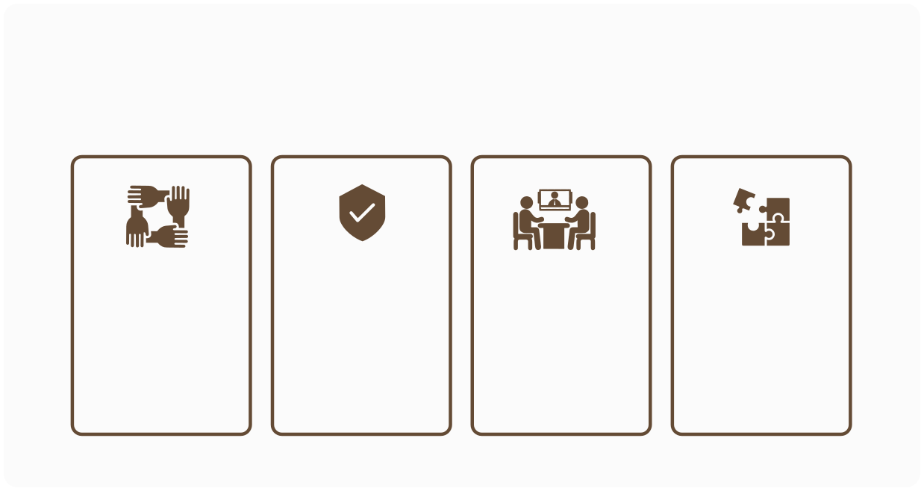
STRONG POINTS
Research projects in different languages
RESCUE guides in different languages
RESCUE magazines
Training courses

Slide 6
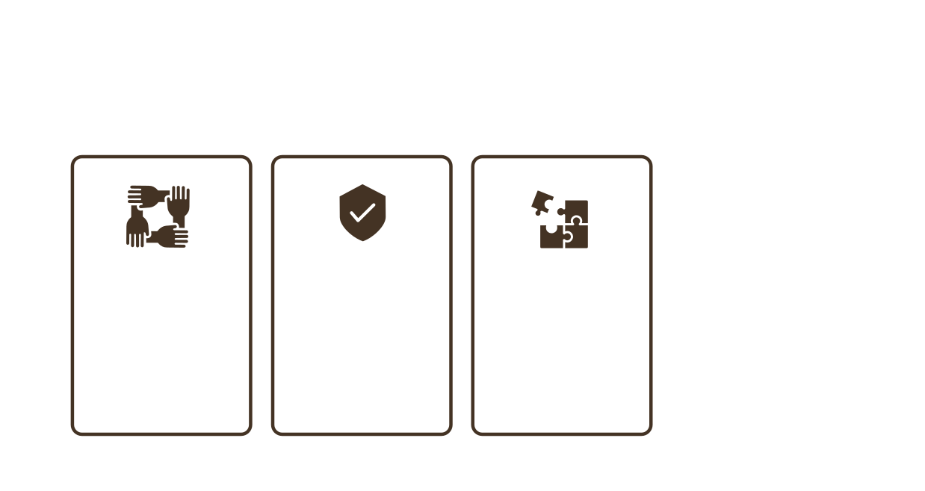
STRONG POINTS
Freely Accessible
Mobile app
RESCUE GIS Maps

Slide 7



WEAK POINTS
01
No social media accounts or sharing
02
Just five languages
03
Lack of tutorials and visuals
04
Less mobile phone friendly

Slide 8



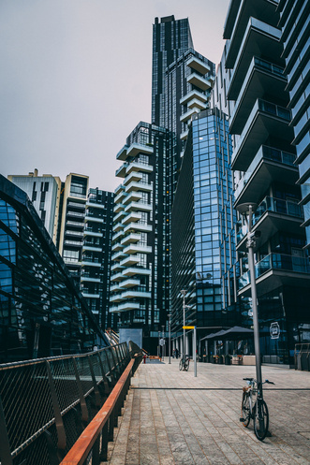
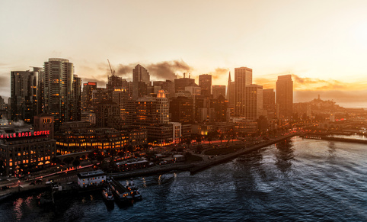
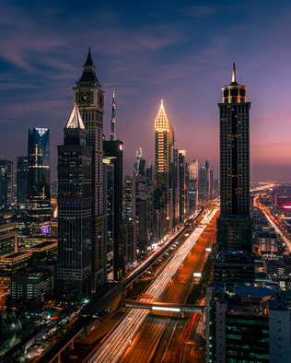
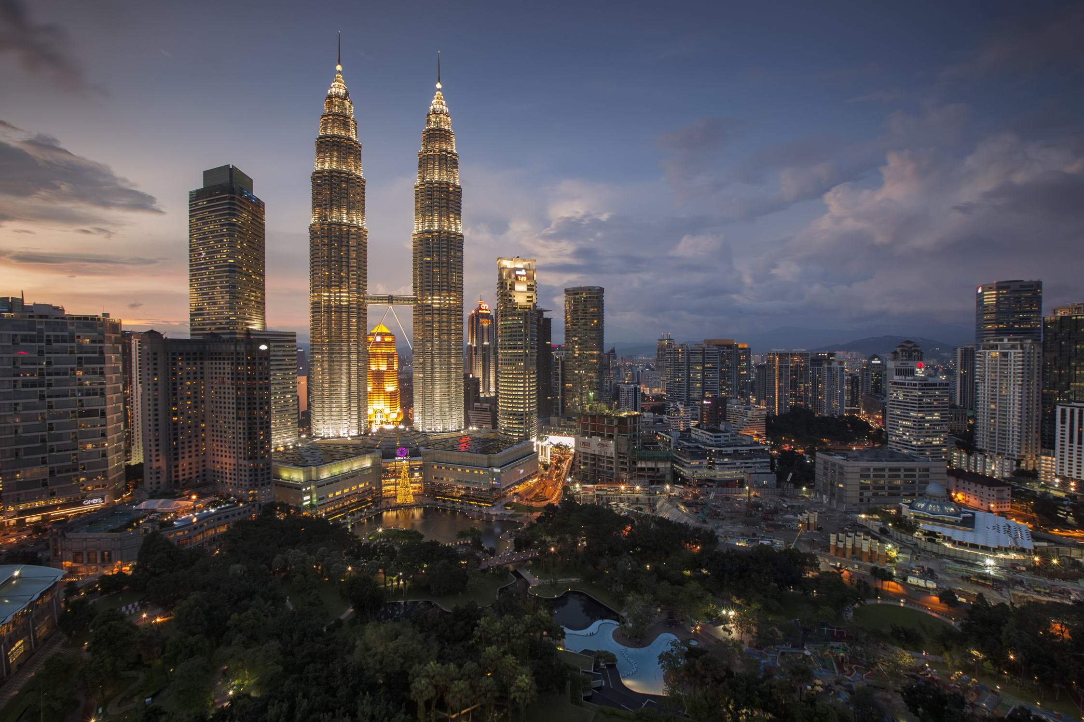
PROPOSALS FOR IMPROVEMENTS
Total Access to the Courses for the Guests
Live Online Courses
and Interactive Meetings
More Vivid Visuals

Slide 9
PROPOSALS FOR IMPROVEMENTS
More Social Media Presence
More Languages
More Mobile Phone Friendly

Slide 10


01
02
03
04
Need to have strong arguments to convince
young people
More languages to enable youth in different nations benefit from the platform
Visualising the content to make it more appealing for young people
Contact other NGOs and share the platform with them

Slide 11
05
06
07
08
Make them participate in the design of the platform
Have them as instant audience
Visualising the content to make it more appealing for young people
Give young creative youth the opportunity to publish/post their creative products and courses related to theme of the platform

Slide 12

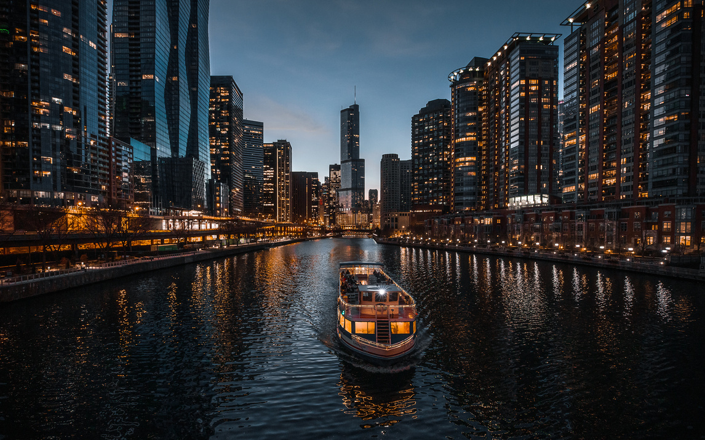


TEAM MEMBERS
Carmina Elena Vant
Davit Avanesyan
ELASTIC
Youth Opportunities Club (YOC)
Nouha Karray
Mehmet Cemil Simsek
Association Samebelle
Karaman Youth Club
Sarra Chemli
WeYouth.org

Slide 13




Guide for NGO’s

Slide 14




  COLLECTION OF GOOD PRACTICES
  CONNECTION TO 11 YOUTH GOALS
  PROPOSAL / IDEAS FOR IMPROVEMENT AND/OR CREATION OF NEW YOUTH SPACES

Slide 15




CHAPTER 1
METHODOLY
CHAPTER 2
THE GUIDE
CHAPTER 3
RECOMMENDATIONS
SUMMARY

Slide 16

METHODOLOGY
CHAPTER 1

Slide 17




BRAINSTORM
PRESENTATION OF OUTCOMES

Slide 18
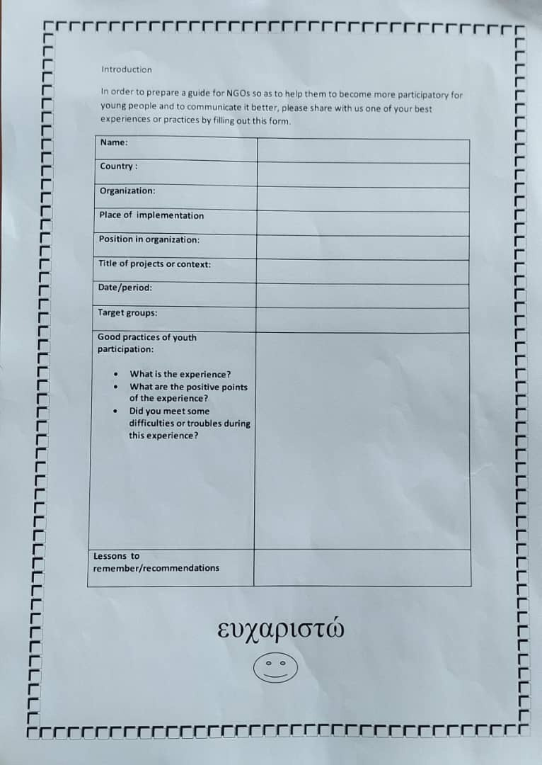

FORM

Slide 19
THE GUIDE
CHAPTER 2

Slide 20



CONTEXT
EU YOUTH STRATEGY
GOALS

Slide 21
Introduction:
Youth spaces are important for the youth because it 's providing them with opportunities to watch, learn from, and even participate in space-based research.
Today we can find hundreds of guides and documents that deal with the theme of youth participation in youth spaces, but the particularity of our guide is the fact that it is based on different angles of view because it is thought out by young people for young people.
In this guide you will find diffrent expample of good practices,
  Collection of good practices
  Connection to 11 Youth Goals
  Proposals / ideas for improvements and/or creation of new spaces.
The guide is made here in Lefkada, Greece on a Erasmus + project. We gather around 15 counties for this project.
This guide will be resource tool that we allow all stakeholders to see it clearly to be able to refer to it in there youth work.
We want it to be clear, useful, easy and above all innovative, whether for methods or the tools.
CONTEXT

Slide 22



EU YOUTH STRATEGY
THE EU YOUTH STRATEGY IS THE FRAMEWORK FOR EUROPEAN COOPERATION IN THE YOUTH FIELD FOR 2019- 2027. THE STRATEGY IS SET TO IMPROVE THE SITUATION OF YOUNG PEOPLE IN EUROPE BY CREATING MORE AND EQUAL OPPORTUNITIES FOR THEM IN EDUCATION AND THE LABOUR MARKET AND BY PROMOTING THEIR ACTIVE CITIZENSHIP, SOCIAL INCLUSION AND SOLIDARITY.
- THE EU YOUTH STRATEGY FOCUSES ON THREE CORE AREAS OF ACTION, AROUND THE THREE WORDS:
ENGAGE, CONNECT, EMPOWER, WHILE WORKING ON JOINED-UP IMPLEMENTATION ACROSS SECTORS.

Slide 23


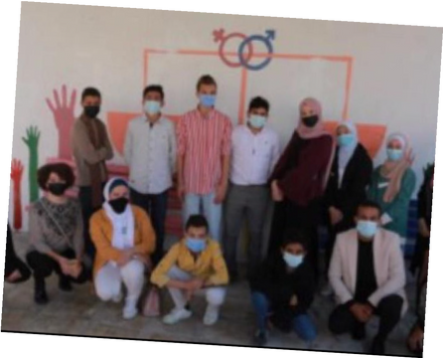
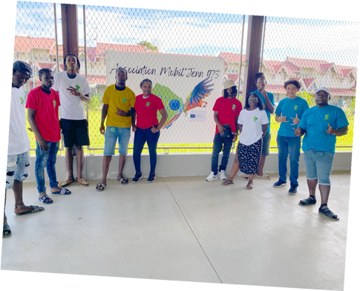
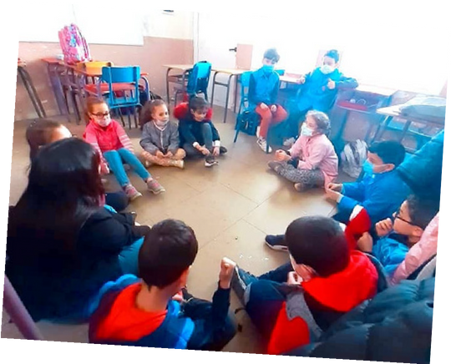

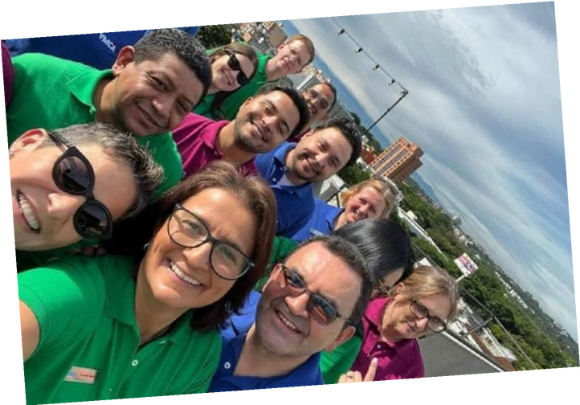
GOALS

Slide 24




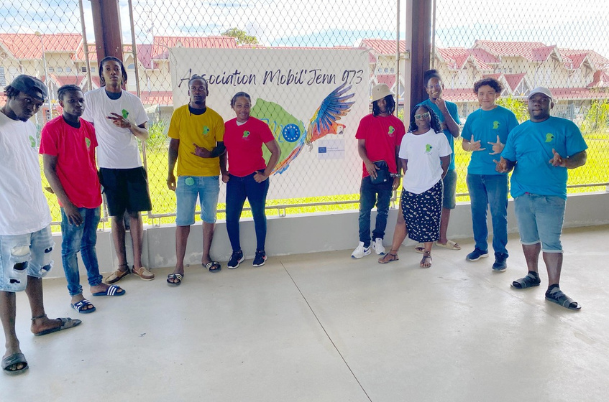


  Present the whole democratic “scope” from the local levels to the highest (EU). And show the young people how their voices can be heard.
  Speed dating with the local elected representatives visit of the city hall “room of deliberation” explanation and role play of vote system
  They were interested in the local levels but as we didn’t have an EU elected representative, Europe felt still very distant to them, they didn’t catch the relevancy of it.
#1
CONNECTING EU WITH YOUTH

Slide 25
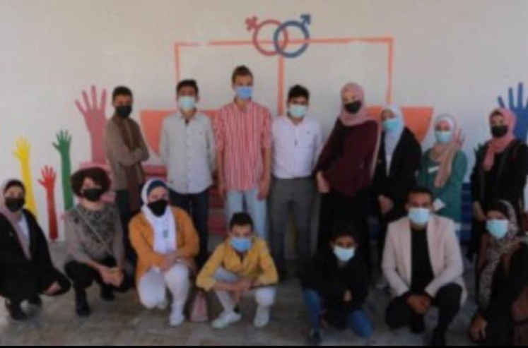

It was very successful project.
The project scale up to include additional community.
The project -connect- the theory with practices with parents involvement
Different –sectors one part- private … & NGO’s Unify the meaning of jimelor equal & the woman & girls involvement on STEAM sector and what is the GBV & how we can create enable environment.
Sure, interconcept
Gender in particular rural areas
#2
EQUALITY OF
All Genders

Slide 26

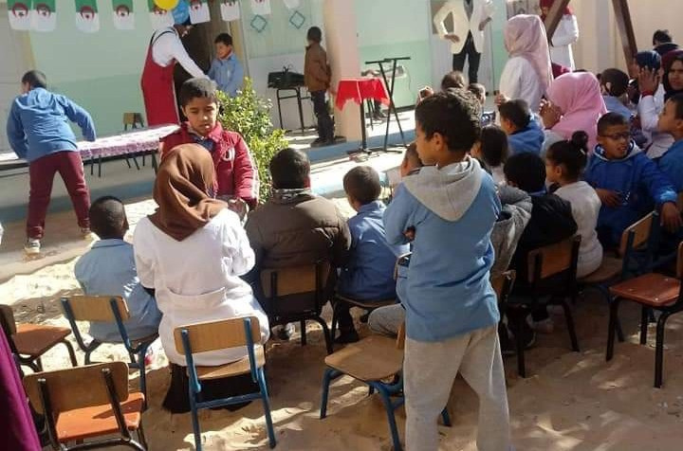
The project is supervised by Tej association and funded by jossour programme. The goals of the project is sensitize youth people about the importance of helping children with disabilities, also it includes many activities. The most important is excursion with children with disabilities led by the supervision of a group of youth people such as positive conduct.
Also training courses such as positive conduct for conflicts and self-affirmation. At the end of the project, a youth form was organized in which 60 young people from various civil society. Topic of form was youth participation in helping children with disabilities.
#3
INCLUSIVE SOCIETIES

Slide 27

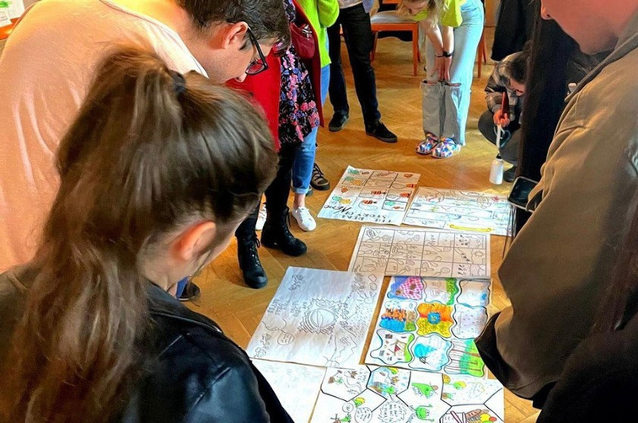
#4
  Inclusive decision-making, creative workshops.
  Empower young people by giving them a platform to voice their opinions and lead community projects.
  Increased engagement, skill development, positive impart
INFORMATION & CONSTRUCTIVE DIALOGUE

Slide 28

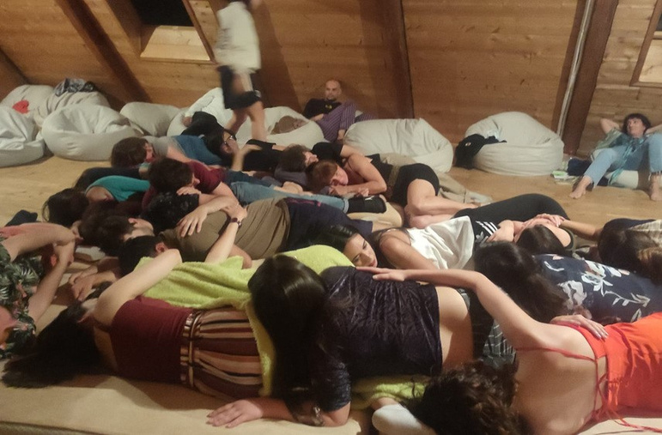
Connect people together Non-formal education Support of dialogue Inner calmness
Connection with yourself and others through touch and other senses
Meditation
To belong and feel safe
Seeing our threats and judgements
#5
MENTAL HEALTH & WELLBEING

Slide 29

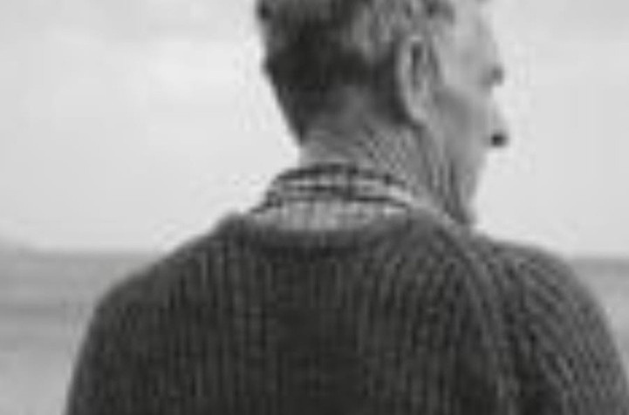
#6
Restoration of old fishing boats
Working with hands, spirit of water, old craft revive, meaningful activity, donation for a good cause, learn English with local people
MOVING RURAL YOUTH FORWARD

Slide 30

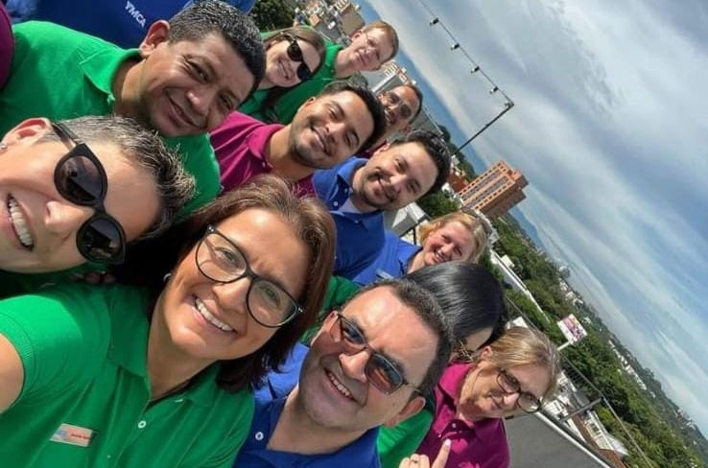
  This experience was one of a kind for me, because I learned a bit of how team should be working together. How all of us as a team can become one.
  To learn to work as a team.
  We learn to deal with the feelings of others and try to understand.
  We learn together, we can reach much more.
  Ye, I did. In my organization, we had a difficulty about the 2 sentors. We as 1 sentor felt like they were favoring the other more and it has become a challenge to deal with one and other. So, at the end of the day we have to work together as 1.
#7
QUALITY EMPLOYMENT FOR ALL

Slide 31

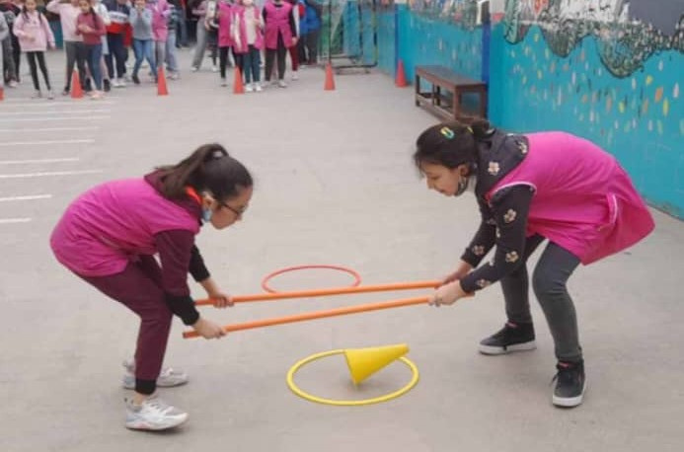
Our project consist of the preparation of a team of animators through a training cycle in order to intervene within schools during recreation and between “classes times” to sensitize students to non-violent communication.
What we liked in this project is the reaction of the children and the animators who were very favorable to the very dynamic methodology of the activities.
#8
QUALITY LEARNING

Slide 32

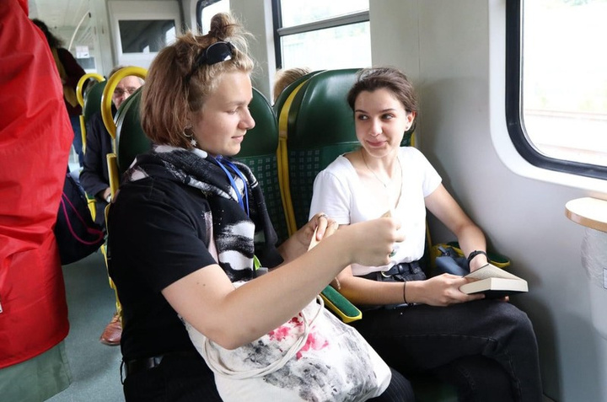
We were travelling by the train to the capital of Poland, Warsaw, and we were presenting Polish poems to travelers.
Everyone get Polish poem and had to read it to the strangers.
The positive experience was happiness of people in the train. Some of them were tired because they were on their way to work, but we made their day better. It was a great occasion to show emotions by art and poem. The difficulties was language barrier.
#9
SPACE AND PARTICIPATION FOR ALL

Slide 33

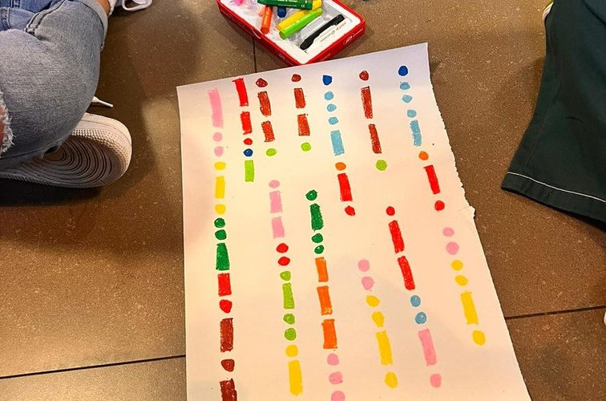
#9
Organize and lead and develop leader skills.
SPACE AND PARTICIPATION FOR ALL

Slide 34

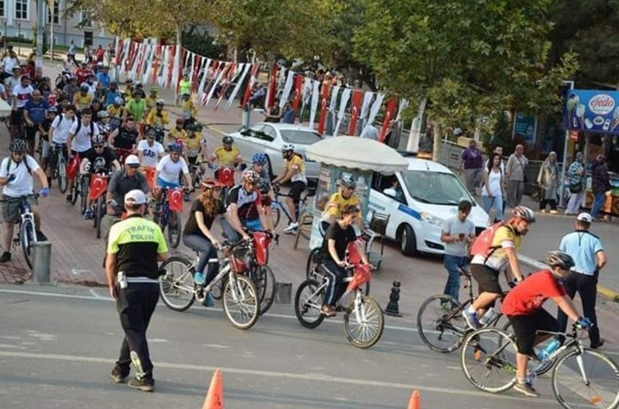
To introduce and activate the cycling culture and the use of the lake path to young people between the ages of 18-30.
Experience: Young people to determine the whole project and route themselves and to carry out correspondence with official institutions.
Some difficulties;
  Young people organizing a project for the first time and lack of experience.
  The closure of the road where the route is located to traffic has negatively affected the existing vehicle traffic for a certain period of time.
#10
SUSTAINABLE GREEN EUROPE

Slide 35
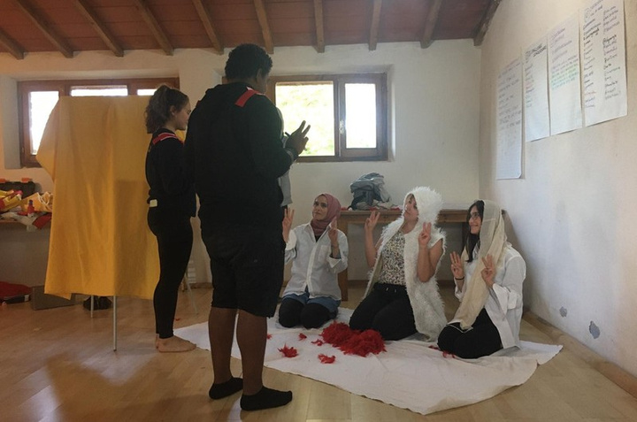

#11
  The project was about “Immigration”.
  The positive point was understanding the minds and the situations of the immigrants.
  I had difficulties while telling the other people how we treat Syrian immigrants. Because they thought that Turkiye was treating them bad, however, it is completely the contrary.
YOUTH ORGANISATIONS & EUROPEAN PROGRAMMES

Slide 36
RECOMMENDATIONS
CHAPTER 3

Slide 37
TERMINOLOGY
MODERN
IDEAS
CLASSIC IDEAS

Slide 38
PARTICIPATION:
  THE ACTION OF TAKING PART IN SOMETHING.
  THE PERIOD BETWEEN CHILDHOOD AND ADULT AGE. ( 13- 30 YEARS OLD)
  İS AN İNVİTİNG HUB FOR TEENS TO FİND İNSPİRATİON, BE CREATİVE, SOCİALİSE AND EQUİP THEMSELVES WİTH THE TOOLS AND SKİLLS TO HELP THEM LİVE LİFE TO THE FULL. (IT'S A WELCOMİNG, SAFE, ALCOHOL AND DRUG FREE SPACE.)
YOUTH:
YOUTH SPACES

Slide 39
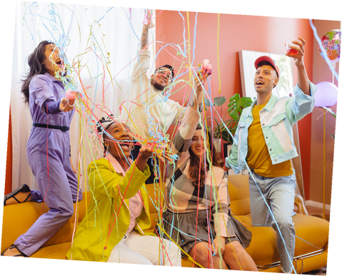
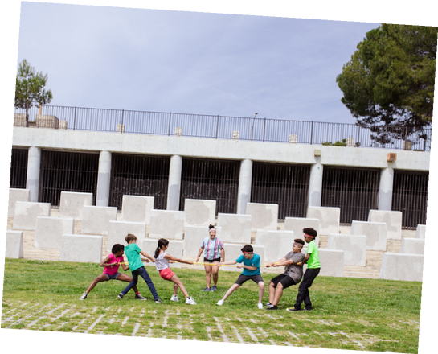
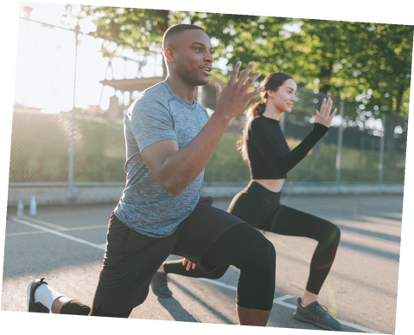

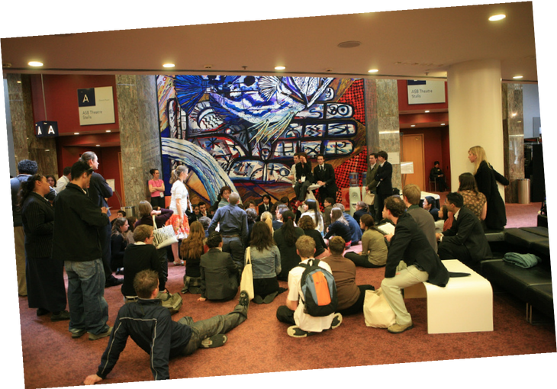
MODERN IDEAS

Slide 40

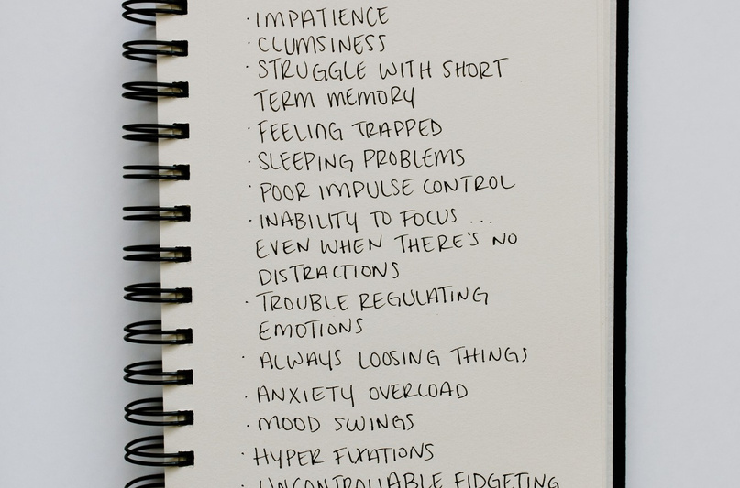
1. Youth mental health centers: estabilish safe spaces where young people can access mental health support, counselling and workshop to address the increasing mental health challenges.
MODERN IDEAS

Slide 41
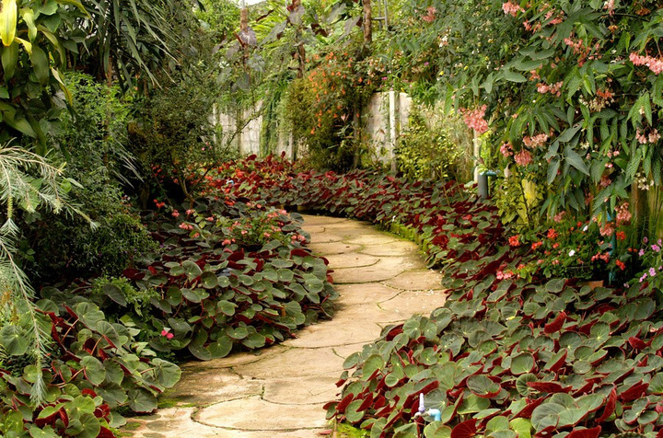
2. Green spaces and gardens: develop community gardens and green spaces where youth can learn about gardening, sustainability and environmental stewardship. These places can also be used for relaxation and meditation.
MODERN IDEAS

Slide 42
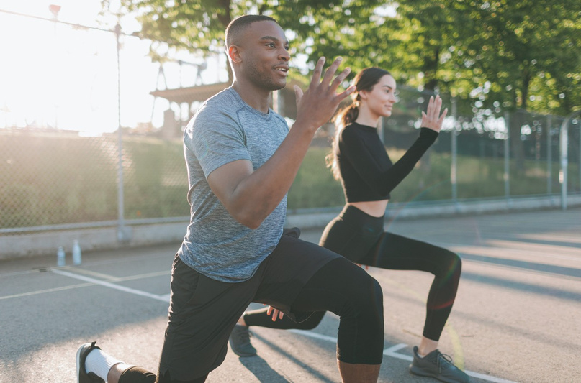
3. Youth fitness centers: develop fitness centers tailored to the needs and preferences of young people, offering a variety of fitness classes, nutrition education and wellness programs.
MODERN IDEAS

Slide 43
CLASSIC IDEAS

Slide 44
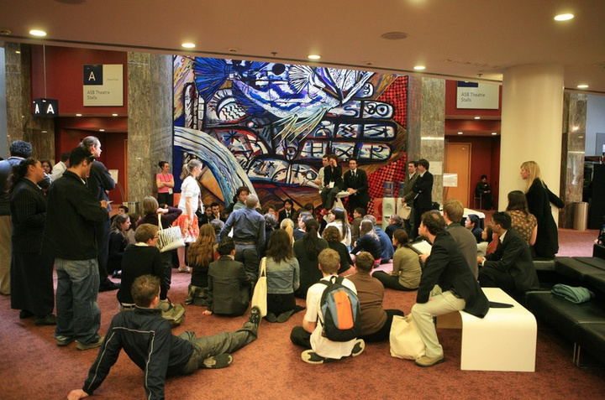
1. Youth centers: create places where young people can meet, talk, participate in Workshop and cultural activities and develop their skills.
CLASSIC IDEAS

Slide 45
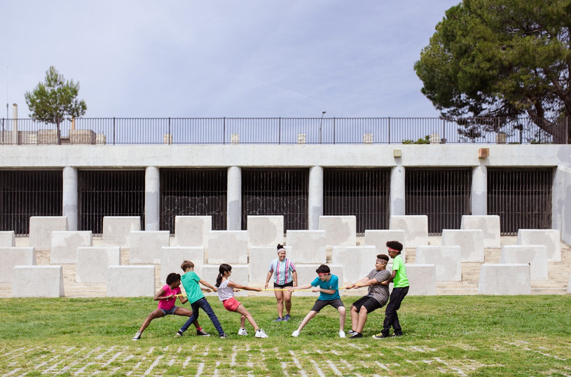
2. Recreational parks: build spaces with modern recreational equipment, basketball courts, beach volleyball courts and other sport activities to encourage them to do sport.
CLASSIC IDEAS

Slide 46
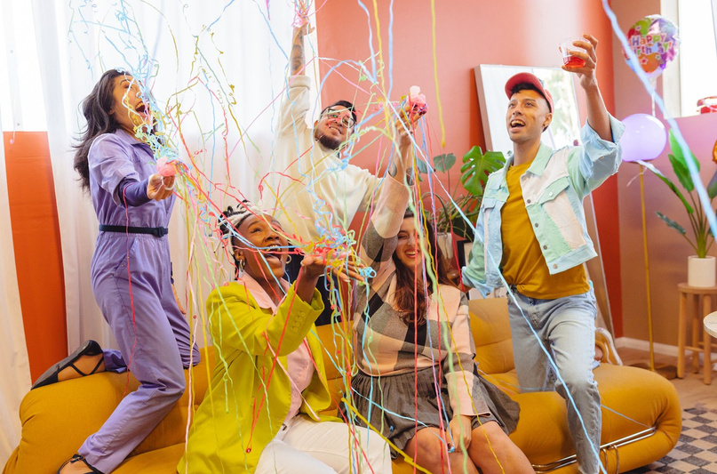
3. Cultural exchange centers: build centers that celebrate cultural diversity and provide a platform for youth to learn about different cultures through art, food and educational events.
CLASSIC IDEAS

Slide 47

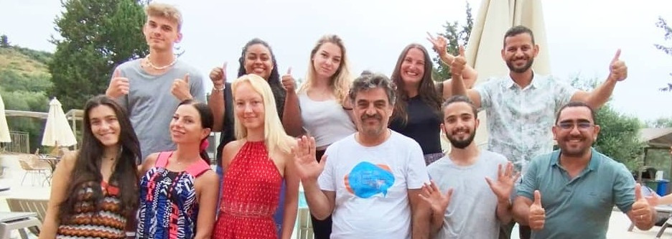
SILA, SALAH, BOUALEM, ILONA, LUCY, INA, EMRE , SVETLANA, IGA, KACPER, MEDIN

Slide 48
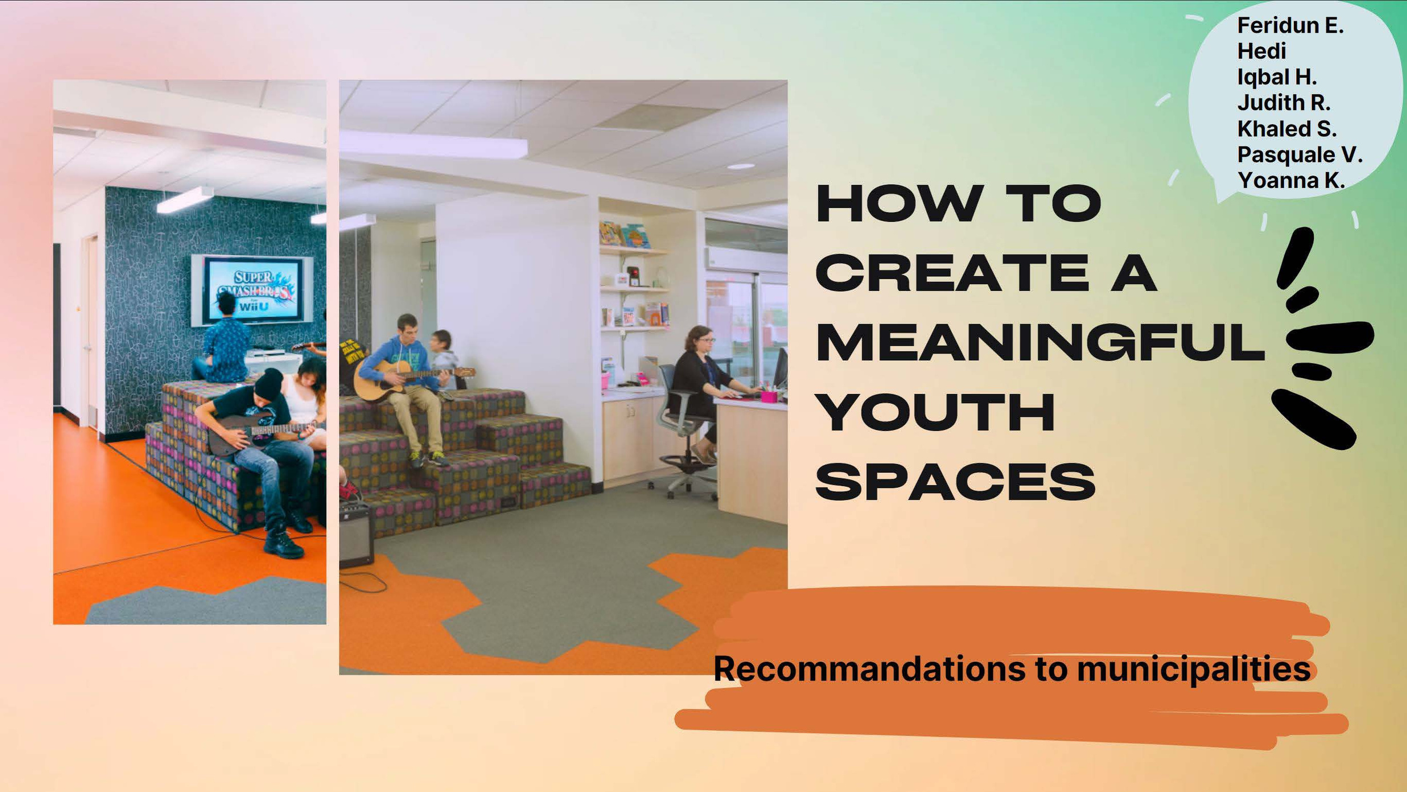

feridun E.
Hedi
Iqbal H.
Judith R.
Khaled S.
Pasquale V.
Yoanna K.
HOW TO CREATE MEANINGFUL YOUTH SPACES
Recommendations to municipalities

Slide 49
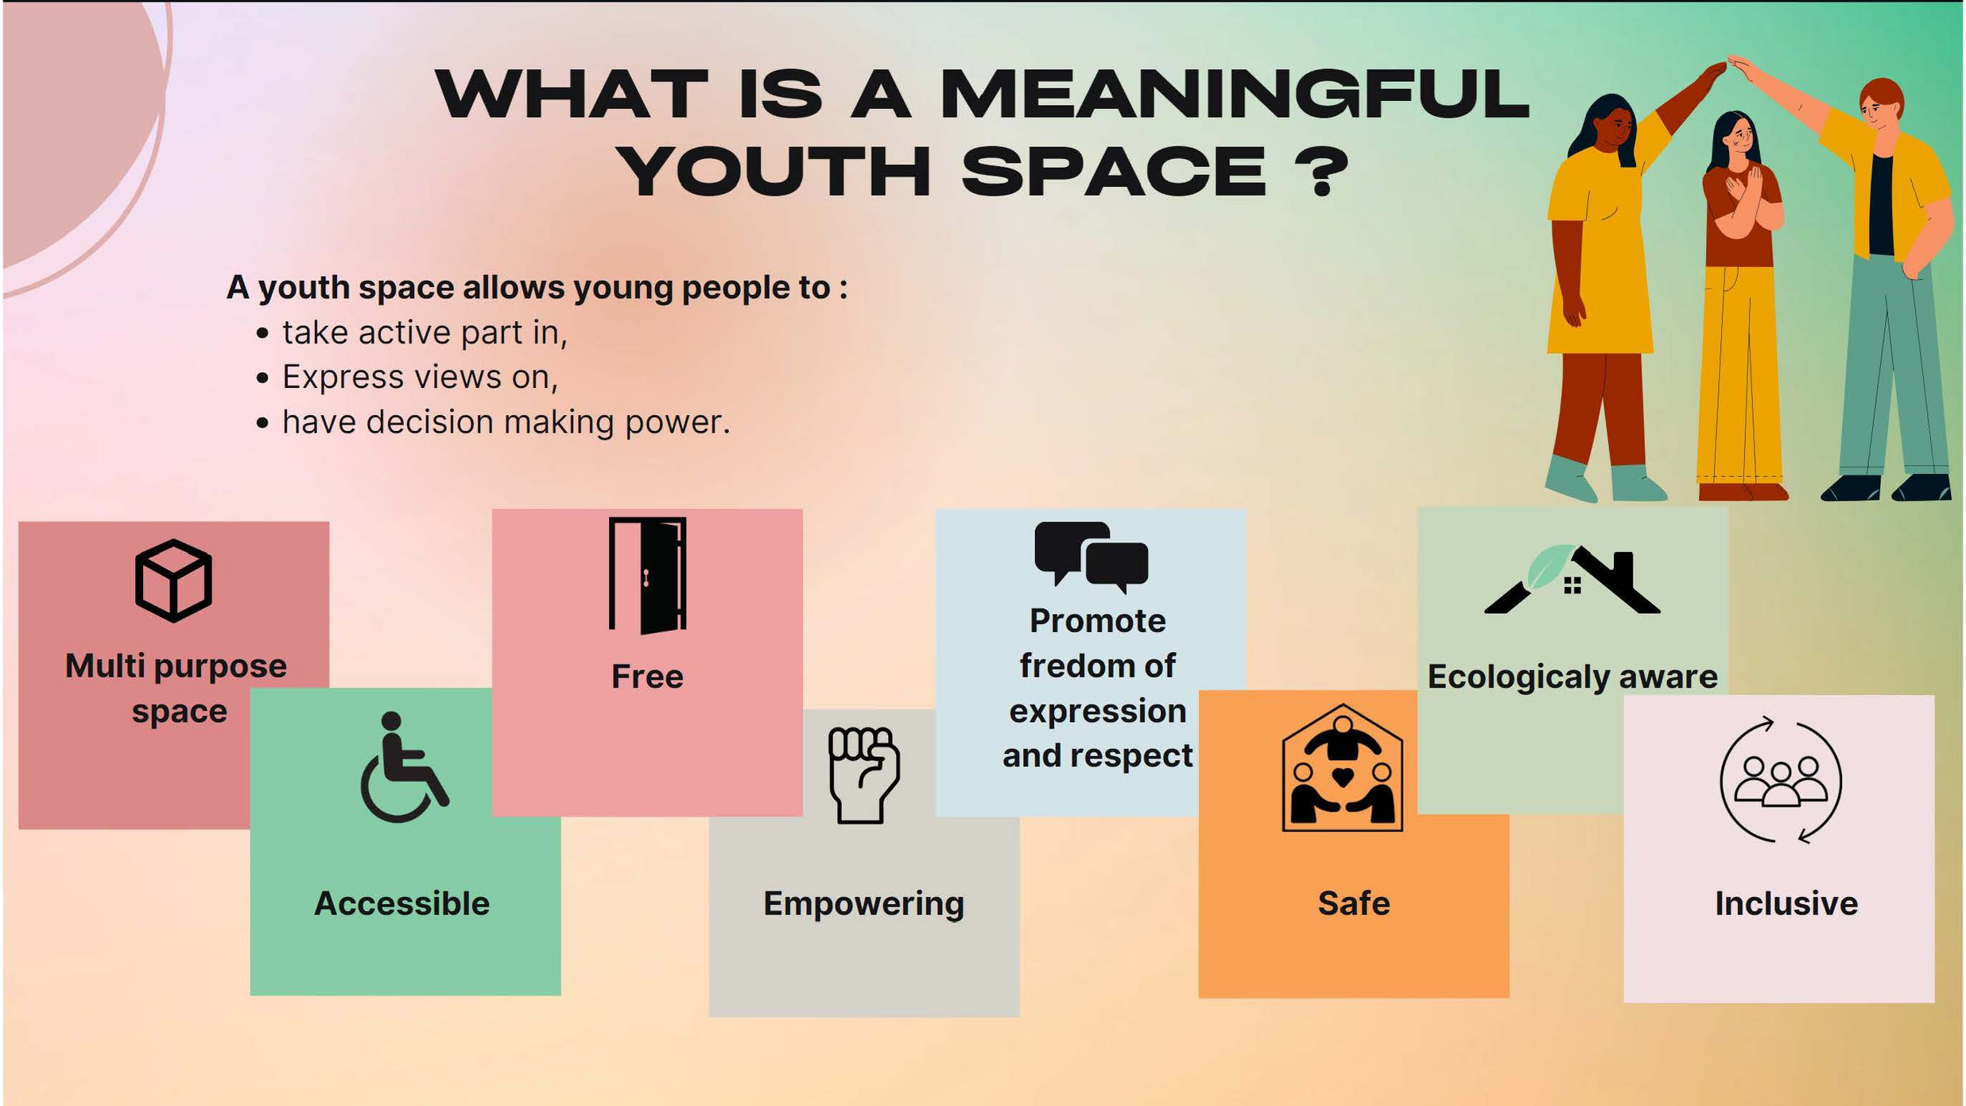

Slide 50
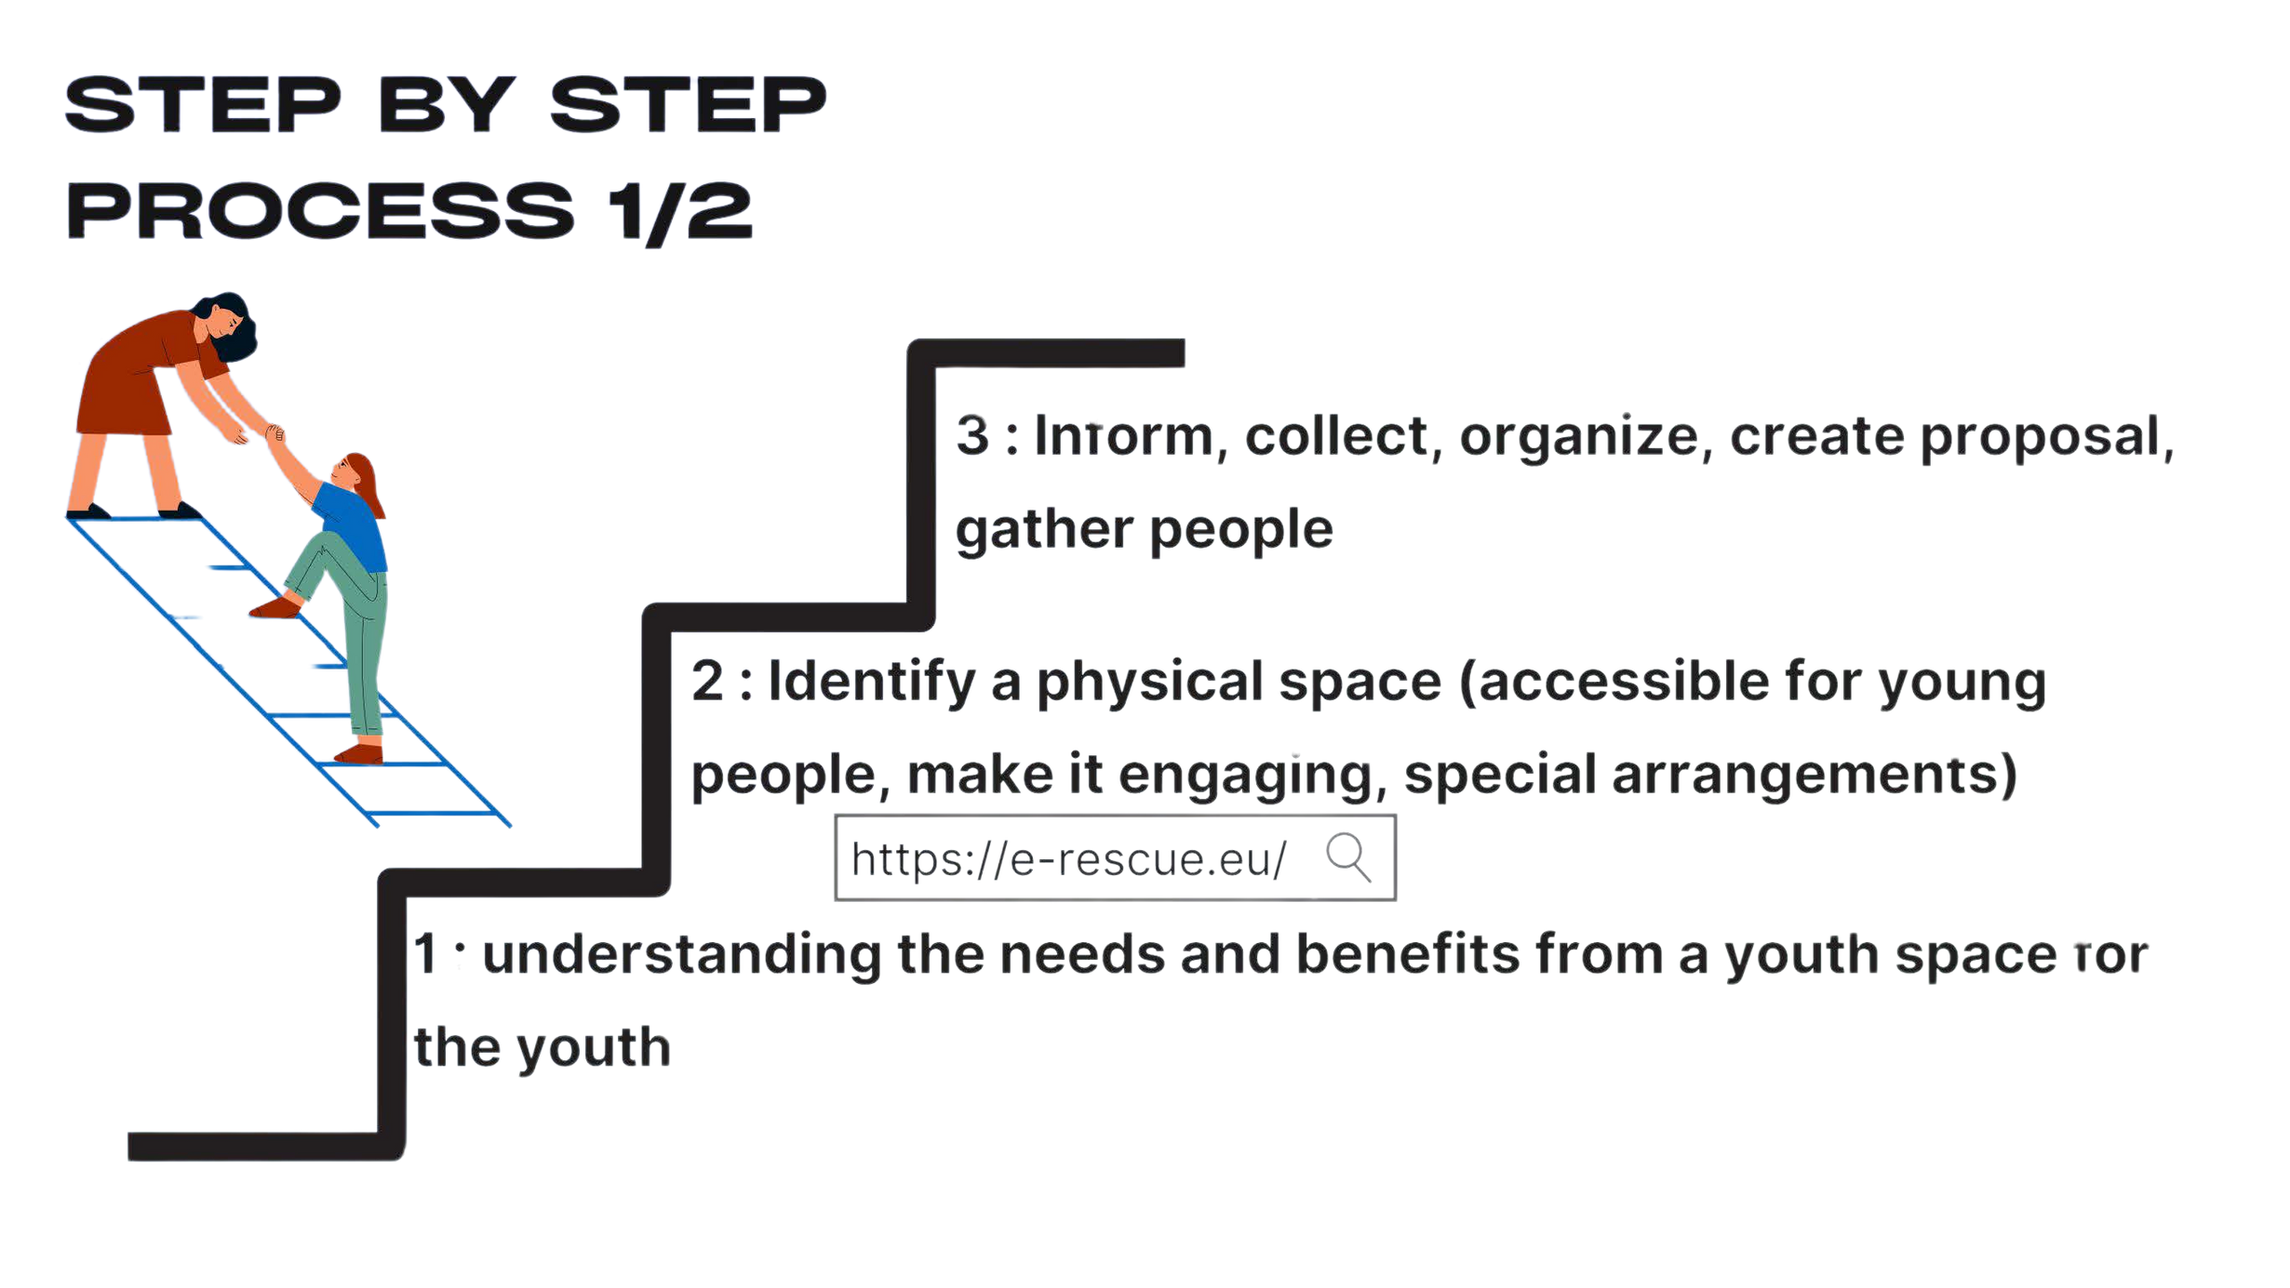

Slide 51
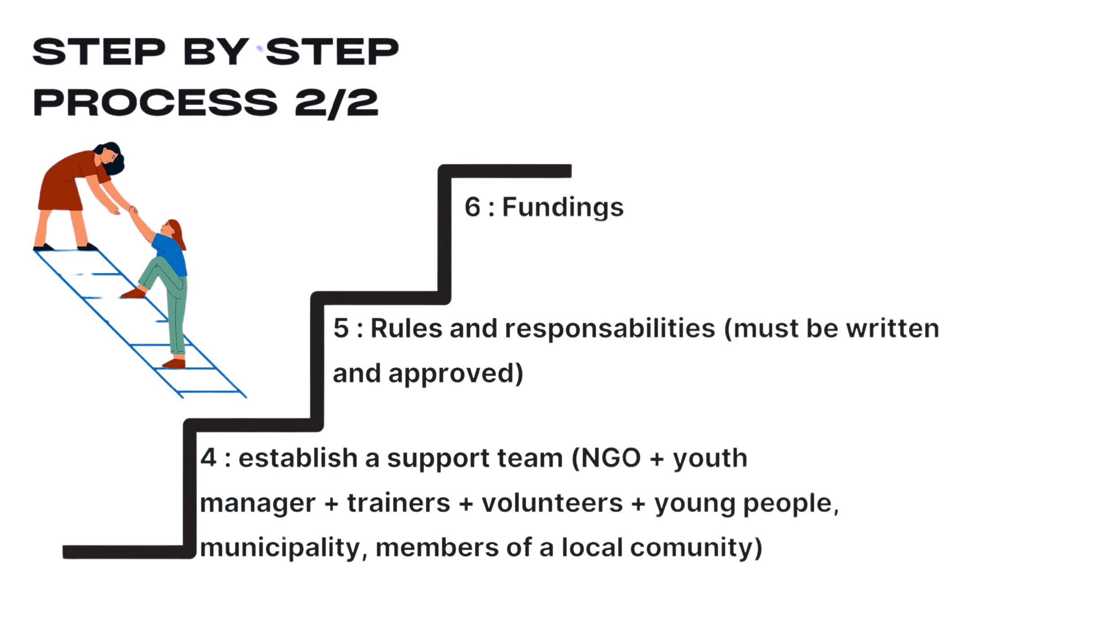

Slide 52
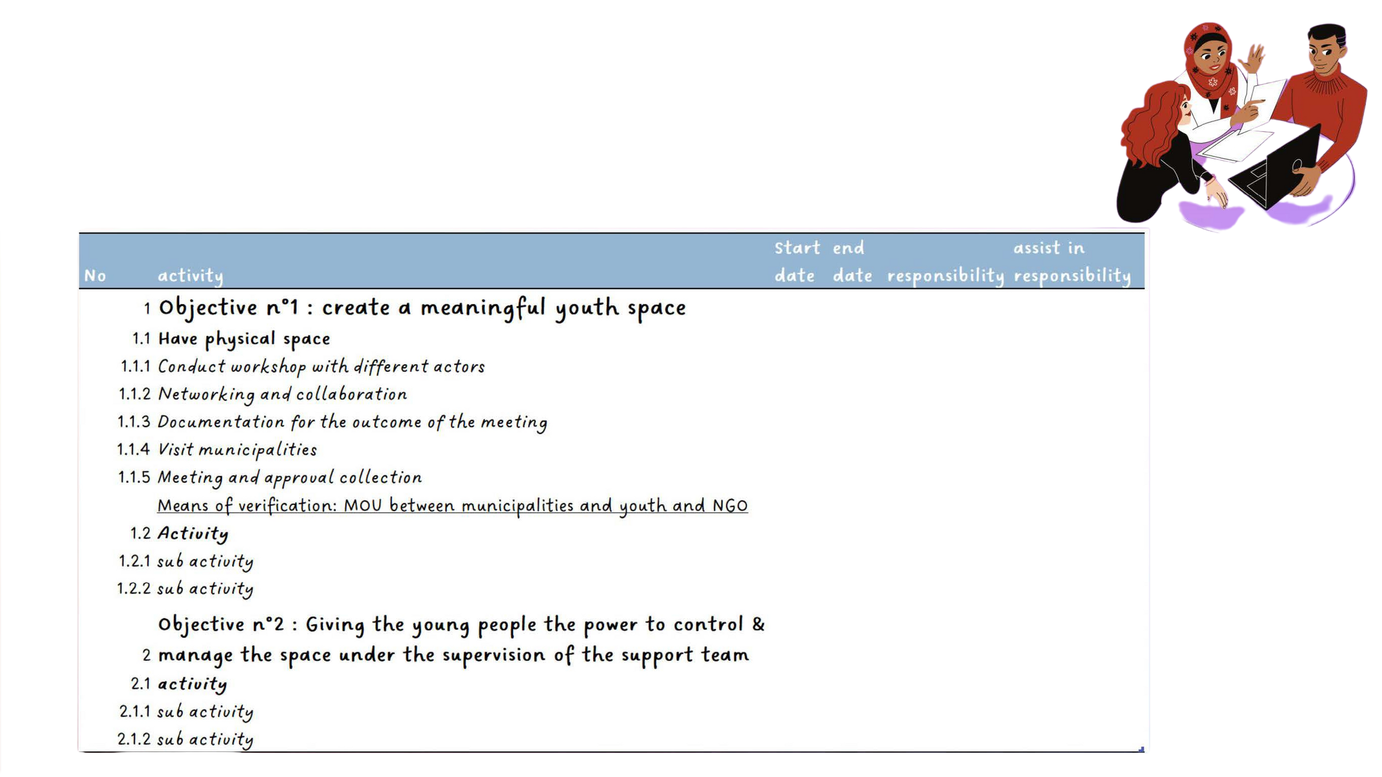
ACTION PLAN EXAMPLE

Slide 53
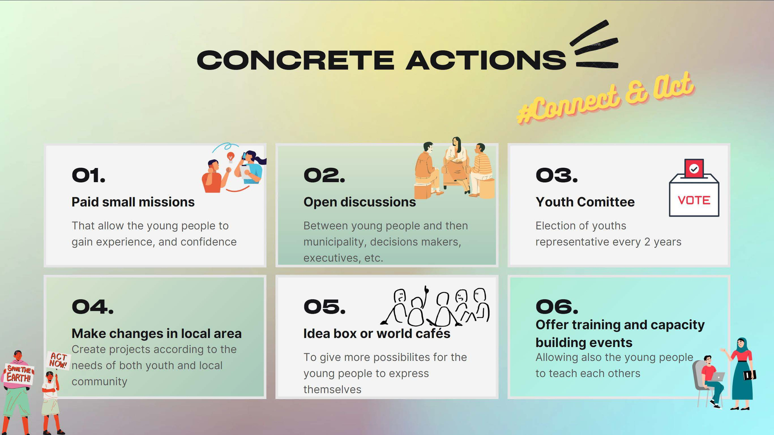

Slide 54
The European Commission's support for the production of this publication does not constitute an endorsement of the contents, which reflect the views only of the authors, and the Commission cannot be held responsible for any use which may be made of the information contained therein

Slide 55
















PARTNERS

